Slide 1
Object Recognition Using Neural Networks
Finally, a use for all those cat videos
Presenter: Edward Preble
DOG
CAT

Slide 2
Intro
Edward Preble, Data Scientist at RTI International
NCSU Institute for Advanced Analytics Class of 2017
Background:
Degrees in science and engineering (nuclear eng., materials science)
Worked in semiconductor industry for 15 years
All slides and code on my github page: https://github.com/epreble/
Intro

Slide 3
Neural networks are sooooo complicated…. do I REALLY need to care???
YES

Slide 4
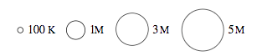
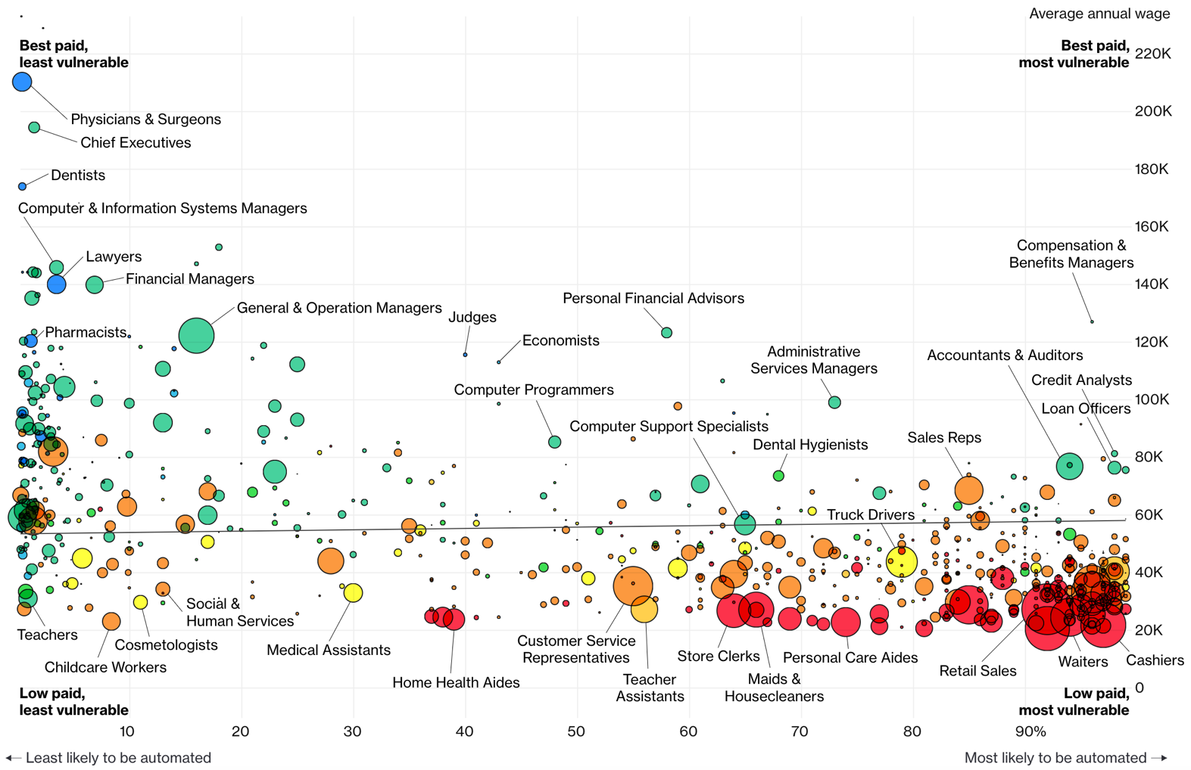
Jobs likely to be displaced by automation (esp. Neural Networks)
Bloomberg 7/2017

Slide 5
How are CNN’s going to automate jobs?
CNN’s are enabling a big leap for sensory data processing (auditory, visual, IoT sensors)
Image Recognition Accuracy
95-98% accuracy is a typical benchmark to outperform humans
Intro

Slide 6
Agenda
Choose your adventure
Theory Focus – Inside CNNs
-OR-
Application Focus – Demo’s
How Neural Networks Work
Tensorflow Playground Demo
(Not too mathy)
Backpropagation
Transfer Learning
Transfer Learning
Face Recognition Demo
Live-train a model to recognize
3 students
Applications
Intro

Slide 7
Agenda
Choose your adventure
Theory Focus – Inside CNNs
-OR-
Application Focus – Demo’s
How Neural Networks Work
Tensorflow Playground Demo
(Not too mathy)
Backpropagation
Transfer Learning
Transfer Learning
Face Recognition Demo
Live-train a model to recognize
3 students
Applications
Intro
Transfer
Live Model
Applications
Wrap Up

Slide 8
CNN Diagram for Image Analysis
All Image Pixels
Edges/Curves
Eyes/Nose
Dog
Input Data
Input Layers
Detection Filters
Simple Features
Detection Filters
Complex Features
Classification
Inception v3
(Google CNN Architecture)
Intro
Transfer
Live Model
Applications
Wrap Up

Slide 9
How complex are these things?
All Image Pixels
Edges/Curves
Eyes/Nose
Dog
Input Data
Input Layers
Detection Filter
Simple Features
Detection Filter
Complex Features
Classification
Inception v3
(Google CNN Architecture)
Number of Parameters = 23,200,000
Number of Layers = 48
Intro
Transfer
Live Model
Applications
Wrap Up
Notes:
Back to the structure of the CNN, and how these layers start really working for complex images.
For an image, the input layers, instead of being data points like the playground example, they will be the actual pixel values for the image. The last model I used at RTI had 704x704 pixel input images, with 3 colors (RGB), which translates into ~1.5M input neurons.
So, you feed this image into the network, certain neurons and features will “activate”, which will then output at the end, is it blue or orange? Is it a cat or a dog?
On Inception v3, the number of layers is 48, the number of parameters is ~23M, the number of multiply/add calculations per sweep is ~5B.
This is DEEP LEARNING. There is a ton going on under the hood.

Slide 10
Transfer Learning is a Key Advance
Retraining the last layer is all that is needed for any human recognizable object
ImageNet trained weights for Inception v3 are downloadable
Intro
Transfer
Live Model
Applications
Wrap Up
Notes:
Remember beginning of lecture, to make the 4 blob data work, we could battle with linear features and a few layer/neuron combos
Or, just needed to use the right feature and it works instantly
Google (and others) have figured out those features and pre-trained a number of model architectures

Slide 11
What can we use today?
Great Google-centric demo→ Tensorflow for Poets
Computational platform → Tensorflow
Model architecture → Inception_v3 structure
ImageNet pre-trained weights
Retraining w/ Python scripts
Intro
Transfer
Live Model
Applications
Wrap Up

Slide 12
Agenda
Choose your adventure
Theory Focus – Inside CNNs
-OR-
Application Focus – Demo’s
How Neural Networks Work
Tensorflow Playground Demo
(Not too mathy)
Backpropagation
Transfer Learning
Transfer Learning
Face Recognition Demo
Live-train a model to recognize
3 students
Applications
Intro
Transfer
Live Model
Applications
Wrap Up

Slide 13
Live Face-Recognition Demo
Jupyter Notebook (Python)
Recognize_Students.ipynb
Intro
Transfer
Live Model
Applications
Wrap Up

Slide 14
Agenda
Choose your adventure
Theory Focus – Inside CNNs
-OR-
Application Focus – Demo’s
How Neural Networks Work
Tensorflow Playground Demo
(Not too mathy)
Backpropagation
Transfer Learning
Transfer Learning
Face Recognition Demo
Live-train a model to recognize
3 students
Applications
Intro
Transfer
Live Model
Applications
Wrap Up

Slide 15
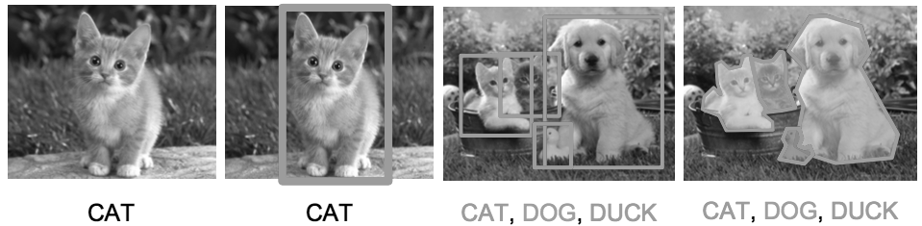
Applications of CNNs in Image Analysis
Classification
& Localization
Instance
Segmentation
Classification
Object Detection
Training Data
Labelling Time/Cost
Medium
High
3 x High
Very High
*Use video data to save time in low complexity use cases
Intro
Transfer
Live Model
Applications
Wrap Up

Slide 16
Existing Applications of Object Detection
Autonomous driving – All driving context objects
Manufacturing – Anomaly detection for quality control
Face recognition – Customer or friend identification
People counting – Store visitor or crowd counting
Online image censoring – Nudity, gore, contraband detection
Security – Automated detection of weapons, intruders
Intro
Transfer
Live Model
Applications
Wrap Up

Slide 17
Object Detection – RTI Use Case
Mosquito breeding site identification in Guatemala
Current Solution
Walking teams
Desired Solution
Target map assists walking team
Intro
Transfer
Live Model
Applications
Wrap Up

Slide 18
Resources to Learn More
Entry Level Videos:
Josh Gordon (Google) Machine Learning Tutorials https://www.youtube.com/watch?v=cKxRvEZd3Mw
Siraj Raval - Various Artificial Intelligence Videos https://www.youtube.com/channel/UCWN3xxRkmTPmbKwht9FuE5A
More Advanced
Adrian Rosebrock (Lots of Python and OpenCV Materials) https://www.pyimagesearch.com/
Intro
Transfer
Live Model
Applications
Wrap Up

Slide 19
Thanks!
Edward Preble Contact Info
Linkedin: https://www.linkedin.com/in/edward-preble/
Github: https://github.com/epreble/
Intro
Transfer
Live Model
Applications
Wrap Up

